Slide 1
International Parity Conditions

Slide 2
Learning Objectives
Examine the link among exchange rates, price level, and interest rates (international parity conditions)
Purchasing Power Parity(PPP)
Interest Rate Parity(IRP)
International Fisher effects(IFE)
Forward Expectation parity(FEP)

Slide 3
International Parity Conditions
The economic theories that link exchange rates, price levels, and interest rates together are called international parity conditions.
These international parity conditions form the core of the financial theory that is unique to international finance.
An understanding of the international parity conditions provides insights into
How foreign exchange rates are determined.
How to forecast foreign exchange rates.

Slide 4
The international parity conditions are manifestations of that law of one price that must hold in arbitrage equilibrium.
Law of one price: the same or equivalent things are trading at the same price across different locations or markets.
Arbitrage: simultaneously buying and selling the same or equivalent assets or commodities for the purpose of making certain, guaranteed profits.
The market can be said to be in equilibrium when no profitable arbitrage opportunities exist.

Slide 5
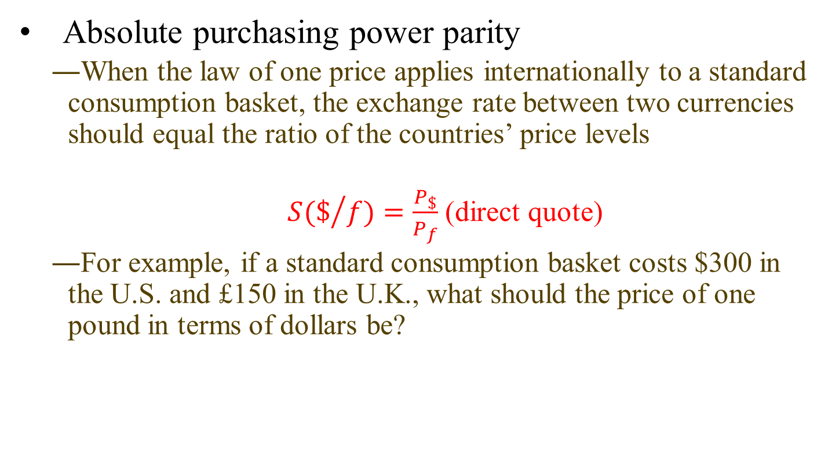
Purchasing Power Parity: Prices and Exchange Rates
Absolute purchasing power parity
When the law of one price applies internationally to a standard consumption basket, the exchange rate between two currencies should equal the ratio of the countries’ price levels
$S(\$/{f)=\frac{P_{\$}}{P_{f}}}$ (direct quote)
For example, if a standard consumption basket costs $300 in the U.S. and £150 in the U.K., what should the price of one pound in terms of dollars be?

Slide 6
“Big Mac PPP”
Source: Data obtained from “The Big Mac Index” The Economist, January, 2021

Slide 7
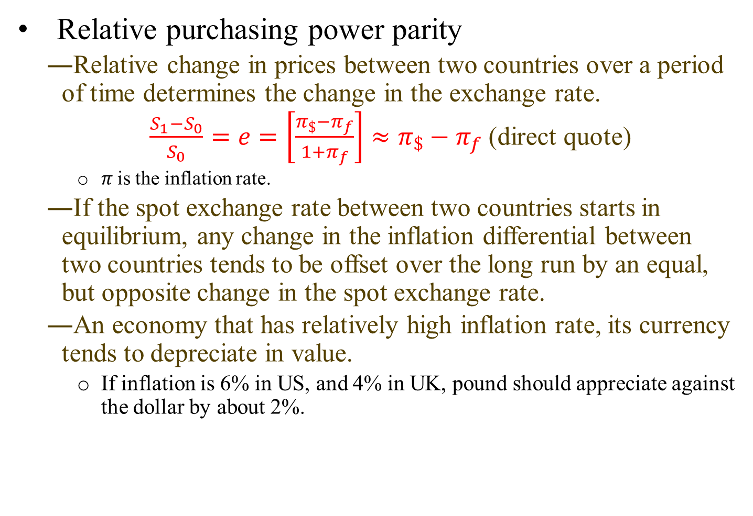
Relative purchasing power parity
Relative change in prices between two countries over a period of time determines the change in the exchange rate.
$\frac{S_{1}−S_{0}}{S_{0}}=e=\left[\frac{π_{\$}−π_{f}}{1+π_{f}}\right]≈π_{\$}−π_{f}$ (direct quote)
$π$is the inflation rate.
If the spot exchange rate between two countries starts in equilibrium, any change in the inflation differential between two countries tends to be offset over the long run by an equal, but opposite change in the spot exchange rate.
An economy that has relatively high inflation rate, its currency tends to depreciate in value.
If inflation is 6% in US, and 4% in UK, pound should appreciate against the dollar by about 2%.

Slide 8
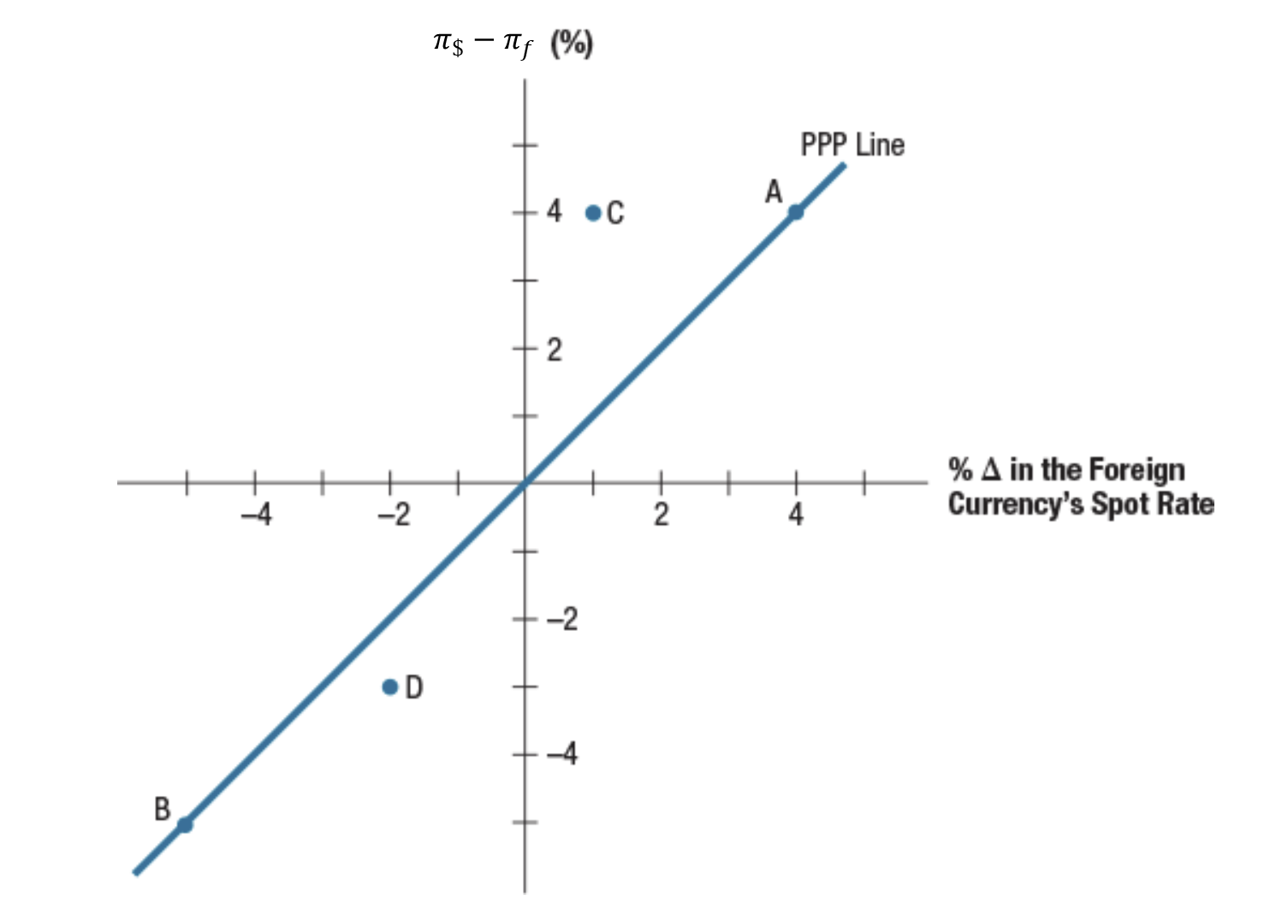
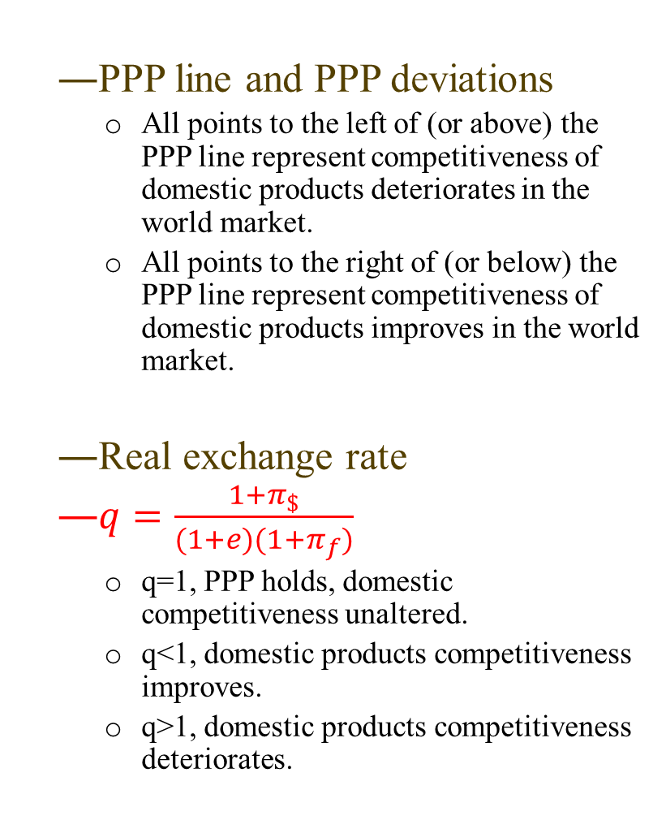

PPP Deviations and the Real Exchange Rate
PPP line and PPP deviations
All points to the left of (or above) the PPP line represent competitiveness of domestic products deteriorates in the world market.
All points to the right of (or below) the PPP line represent competitiveness of domestic products improves in the world market.
Real exchange rate
$q=\frac{1+π_{\$}}{(1+e)(1+π_{f})}$
q=1, PPP holds, domestic competitiveness unaltered.
q<1, domestic products competitiveness improves.
q>1, domestic products competitiveness deteriorates.
$e≈π_{\$}−π_{f}$

Slide 9
Empirical evidence of purchasing power parity
PPP holds up well over the very long run but poorly for shorter time periods.
Reasons for deviations from PPP.
No substitutes for traded products.
Government restrictions.

Slide 10
Interest Rate Parity: Interest Rates and Exchange Rates
Interest rate parity is a manifestation of law of one price applied to international money market instruments.
Suppose you have $1 to invest over a one-year period, and you only consider default-free investment.
Strategy 1: Invest $1 domestically at U.S. interest rate i$, the payoff in one year is $1(1+ i$)
Strategy 2: invest in £ with the following transactions
Exchange $ to £ at spot rate S($/£), which yields £(1/S),
Invest at U.K. interest rate i£. the payoff in one year is £(1/S) (1+ i£)
Sell the amount of the £ payoff forward, which will yield $(1/S) (1+ i£)F in one year.

Slide 11
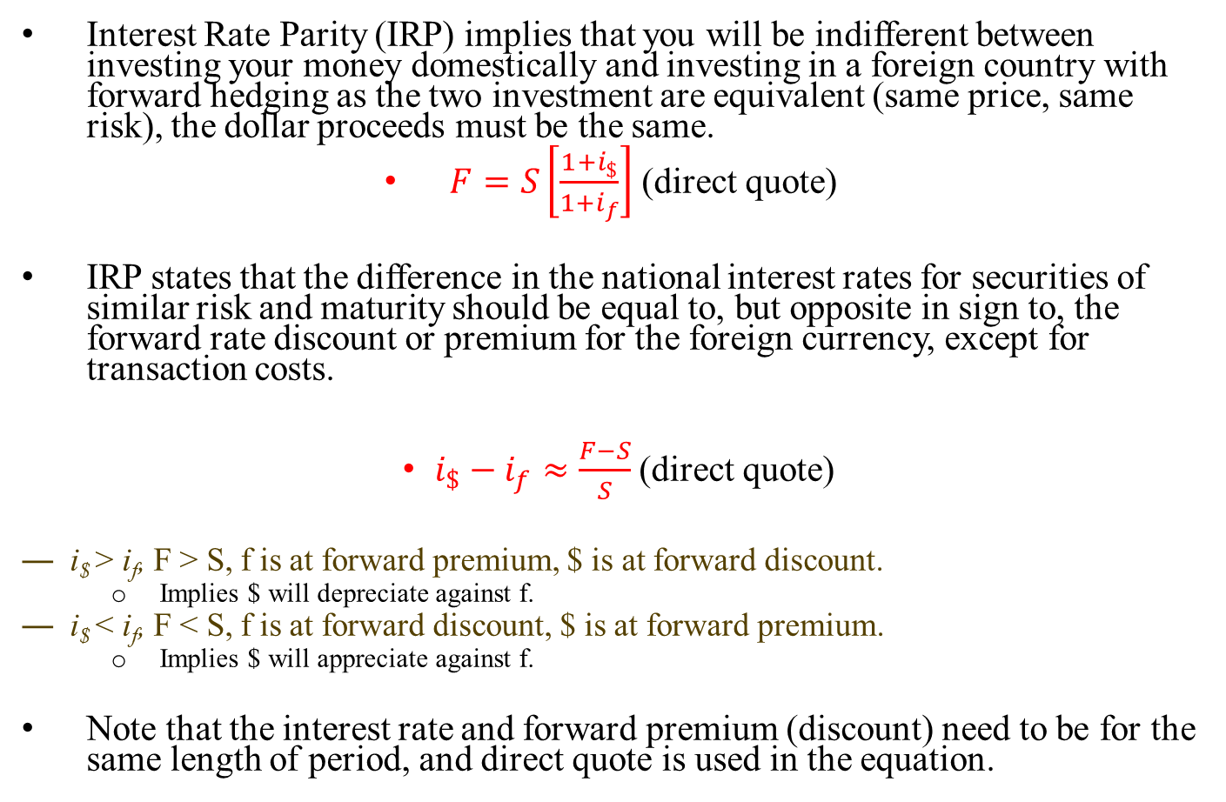
Interest Rate Parity (IRP) implies that you will be indifferent between investing your money domestically and investing in a foreign country with forward hedging as the two investment are equivalent (same price, same risk), the dollar proceeds must be the same.
$F=S\left[\frac{1+i_{\$}}{1+i_{f}}\right]$ (direct quote)
IRP states that the difference in the national interest rates for securities of similar risk and maturity should be equal to, but opposite in sign to, the forward rate discount or premium for the foreign currency, except for transaction costs.
$i_{\$}−i_{f}≈\frac{F−S}{S}$ (direct quote)
i$ > i_{f}, F > S, f is at forward premium, $ is at forward discount.
Implies $ will depreciate against f.
i$ < i_{f}, F < S, f is at forward discount, $ is at forward premium.
Implies $ will appreciate against f.
Note that the interest rate and forward premium (discount) need to be for the same length of period, and direct quote is used in the equation.

Slide 12
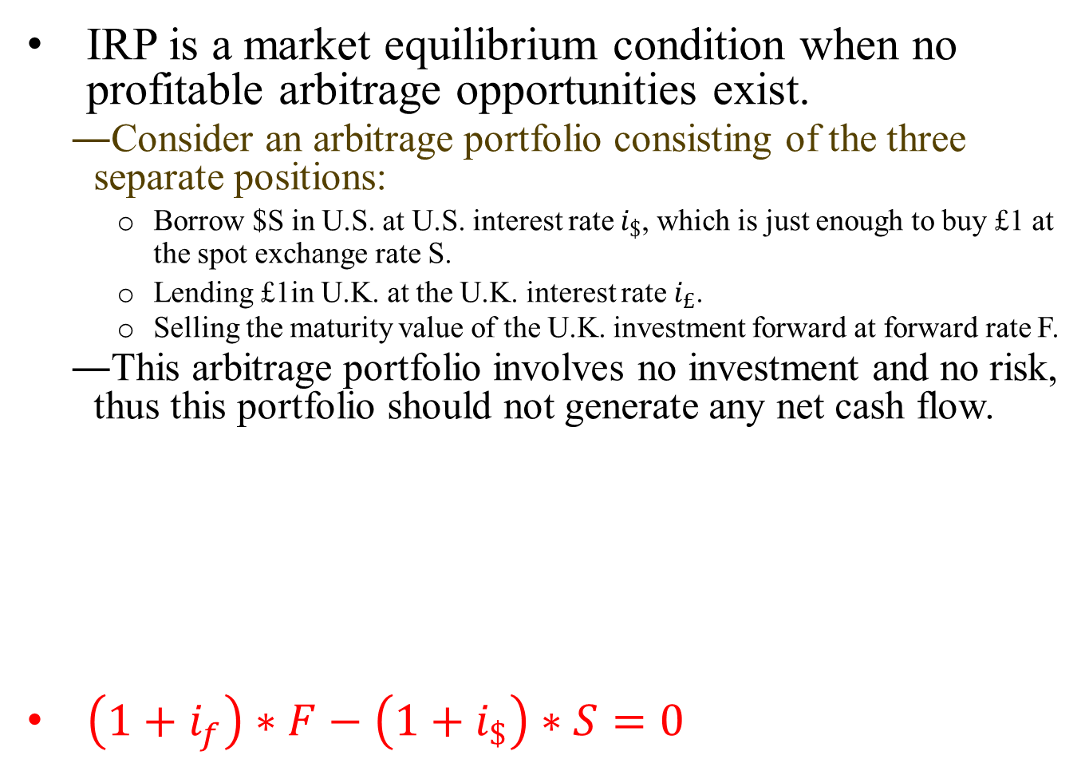
IRP is a market equilibrium condition when no profitable arbitrage opportunities exist.
Consider an arbitrage portfolio consisting of the three separate positions:
Borrow $S in U.S. at U.S. interest rate $i_{\$}$, which is just enough to buy £1 at the spot exchange rate S.
Lending £1in U.K. at the U.K. interest rate $i_{£}$.
Selling the maturity value of the U.K. investment forward at forward rate F.
This arbitrage portfolio involves no investment and no risk, thus this portfolio should not generate any net cash flow.
$\left(1+i_{f}\right)∗F−\left(1+i_{\$}\right)∗S=0$

Slide 13
IRP Deviations and Covered Interest Arbitrage
Suppose that the annual interest rate is 5% in the U.S. and 8% in the U.K. The spot exchange rate is $1.80/£.
Given no arbitrage condition, what should be the one-year forward exchange rate implied by IRP?
If the current forward exchange rate, with one-year maturity, is $1.78/£. Assume that the arbitrager can borrow up to $1,000,000 or £555,556. Is there any arbitrage opportunities? How much profit can the arbitrager make?

Slide 14
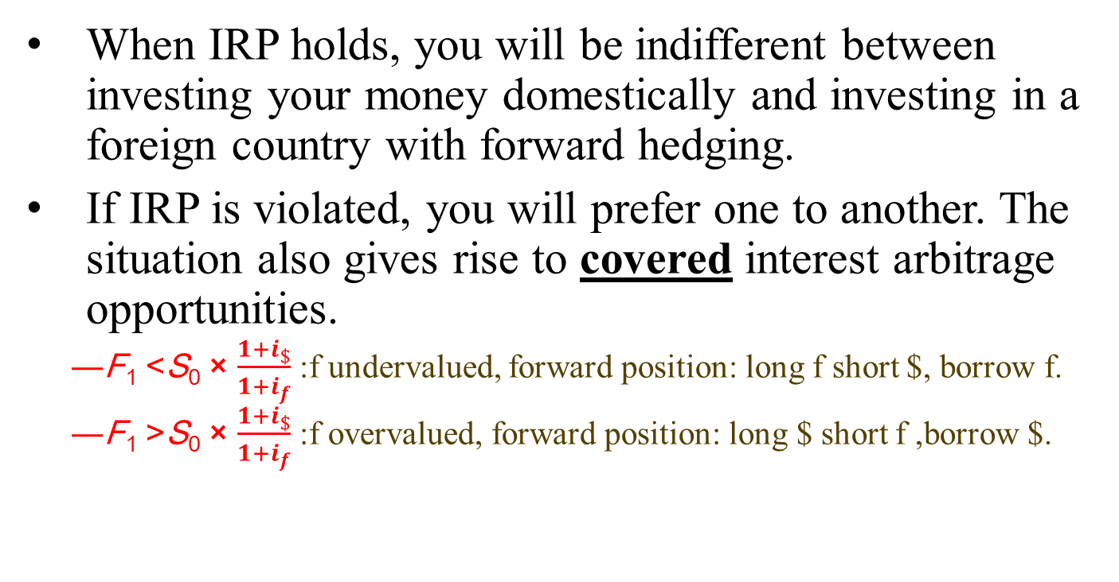
When IRP holds, you will be indifferent between investing your money domestically and investing in a foreign country with forward hedging.
If IRP is violated, you will prefer one to another. The situation also gives rise to covered interest arbitrage opportunities.
F₁ <S₀ × $\frac{1+i_{\$}}{1+i_{f}}$ :f undervalued, forward position: long f short $, borrow f.
F₁ >S₀ × $\frac{1+i_{\$}}{1+i_{f}}$ :f overvalued, forward position: long $ short f ,borrow $.

Slide 15
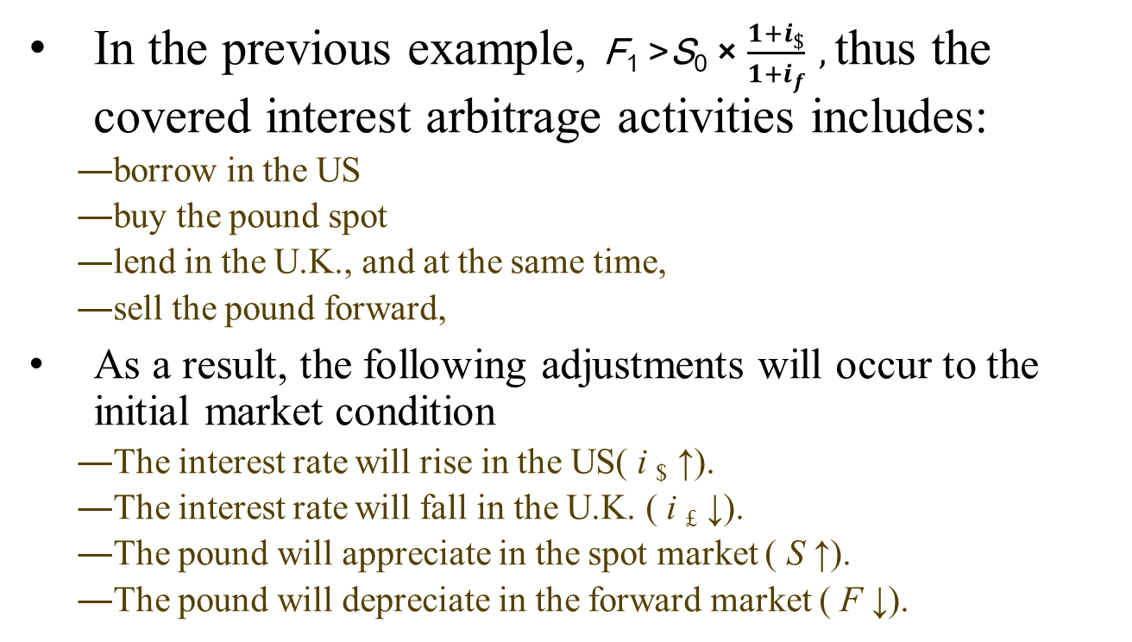
In the previous example, F₁ >S₀ × $\frac{1+i_{\$}}{1+i_{f}} ,$thus the covered interest arbitrage activities includes:
borrow in the US
buy the pound spot
lend in the U.K., and at the same time,
sell the pound forward,
As a result, the following adjustments will occur to the initial market condition
The interest rate will rise in the US( i $ ↑).
The interest rate will fall in the U.K. ( i £ ↓).
The pound will appreciate in the spot market ( S ↑).
The pound will depreciate in the forward market ( F ↓).

Slide 16
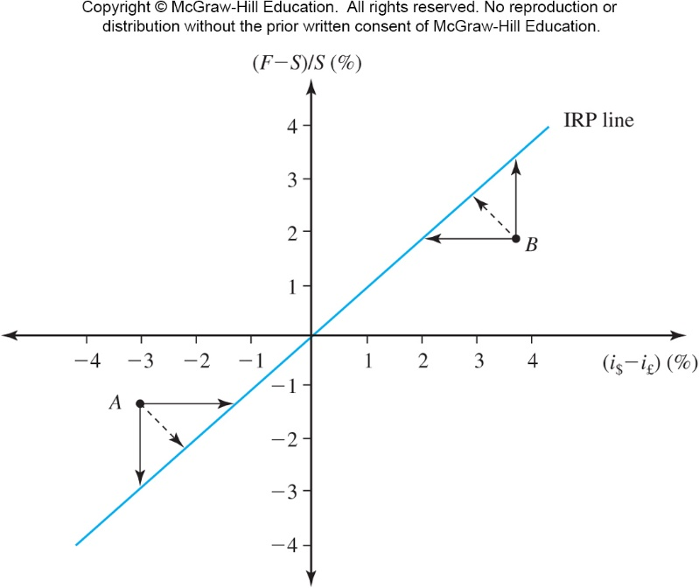


IRP line and adjustments to restore IRP
Point A:
Deviation:$i_{\$}−i_{F}<\frac{F−S}{S}$ or F₁ >S₀ × $\frac{1+i_{\$}}{1+i_{f}}$
Adjustments:
$i_{\$}−i_{F}$ increase
$\frac{F−S}{S}$ decrease
Point B:
Deviation:$i_{\$}−i_{F}>\frac{F−S}{S}$ or F₁ <S₀ × $\frac{1+i_{\$}}{1+i_{f}}$
Adjustments:
$i_{\$}−i_{F}$ decrease
$\frac{F−S}{S}$ increase

Slide 17
Reasons for deviations from IRP.
IRP tends to hold quite well, it may not hold precisely all the time, especially in short run.
Transactions costs, bid-ask spreads.
Government restrictions.
F₁ –S₀
IRP line
S₀
←Unprofitable “arbitrage” opportunity
exploitable arbitrage opportunity →
i$ − i_{f}
Unprofitable arbitrage

Slide 18
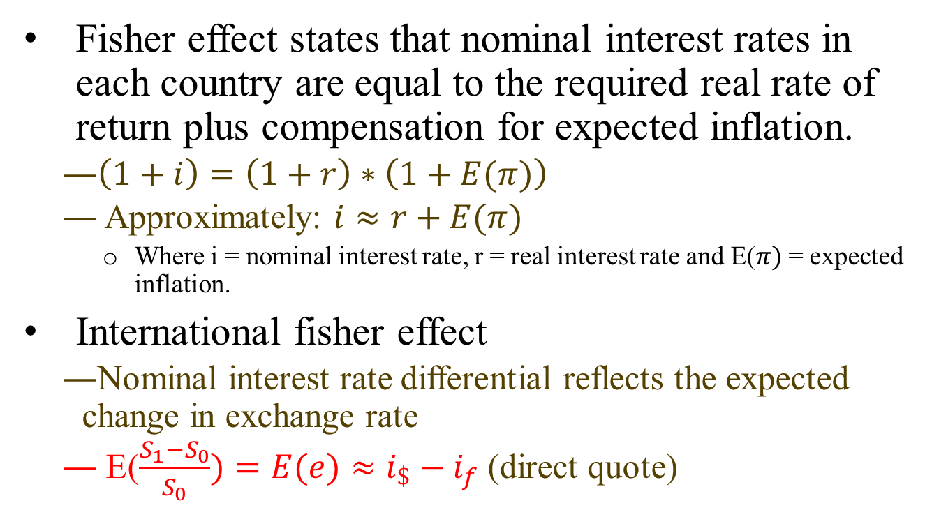
International fisher effect
Fisher effect states that nominal interest rates in each country are equal to the required real rate of return plus compensation for expected inflation.
$\left(1+i\right)=\left(1+r\right)∗\left(1+E(π)\right)$
Approximately: $i≈r+E(π)$
Where i = nominal interest rate, r = real interest rate and E($π)$= expected inflation.
International fisher effect
Nominal interest rate differential reflects the expected change in exchange rate
E($\frac{S_{1}−S_{0}}{S_{0}})=E(e)≈i_{\$}−i_{f}$ (direct quote)

Slide 19
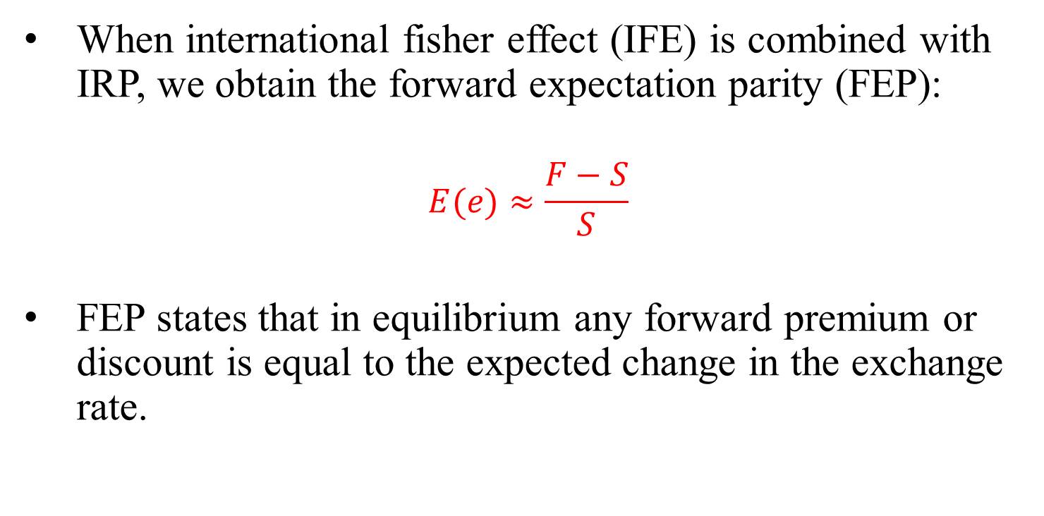
Forward Expectation Parity
When international fisher effect (IFE) is combined with IRP, we obtain the forward expectation parity (FEP):
$$E(e)≈\frac{F−S}{S}$$
FEP states that in equilibrium any forward premium or discount is equal to the expected change in the exchange rate.

Slide 20
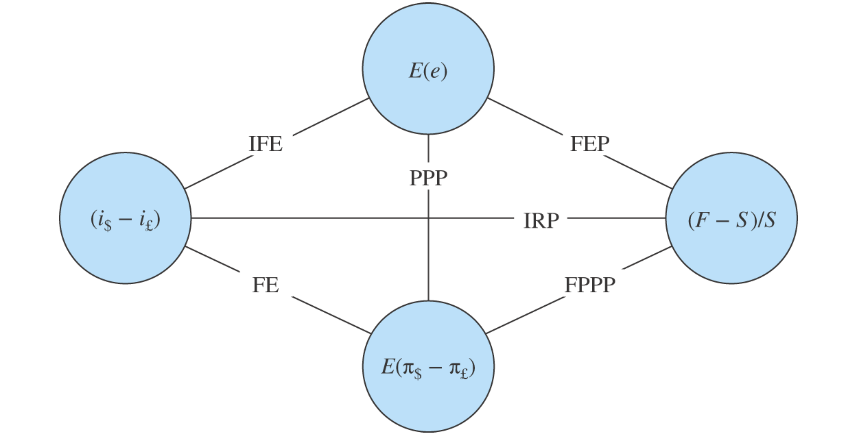
Approximate Equilibrium Exchange Rate Relationships

